Slide 1



Design and Development of LLC Resonant Converter for EV charging
(MTP - Stage 0 )
Aditya Kumar
Guide: Prof. Siddavatam Ravi Prakash Reddy
Electrical Machines & Power Electronic Systems (EMPES) Lab
Department of Energy Science and Engineering
Indian Institute of Technology Bombay

Slide 2

Converter Specifications
Parameter | Value
Input voltage (Vin) | 20 V
Resonant tank inductor (Lr) | 84.142 µH
Resonant tank capacitor (Cr) | 481.667 nF
Resonant frequency (fr) | 25 kHz
Output inductor (L) | 80 µH
Output capacitor (C) | 500 µF
Switches and Diodes | Ideal

Slide 3
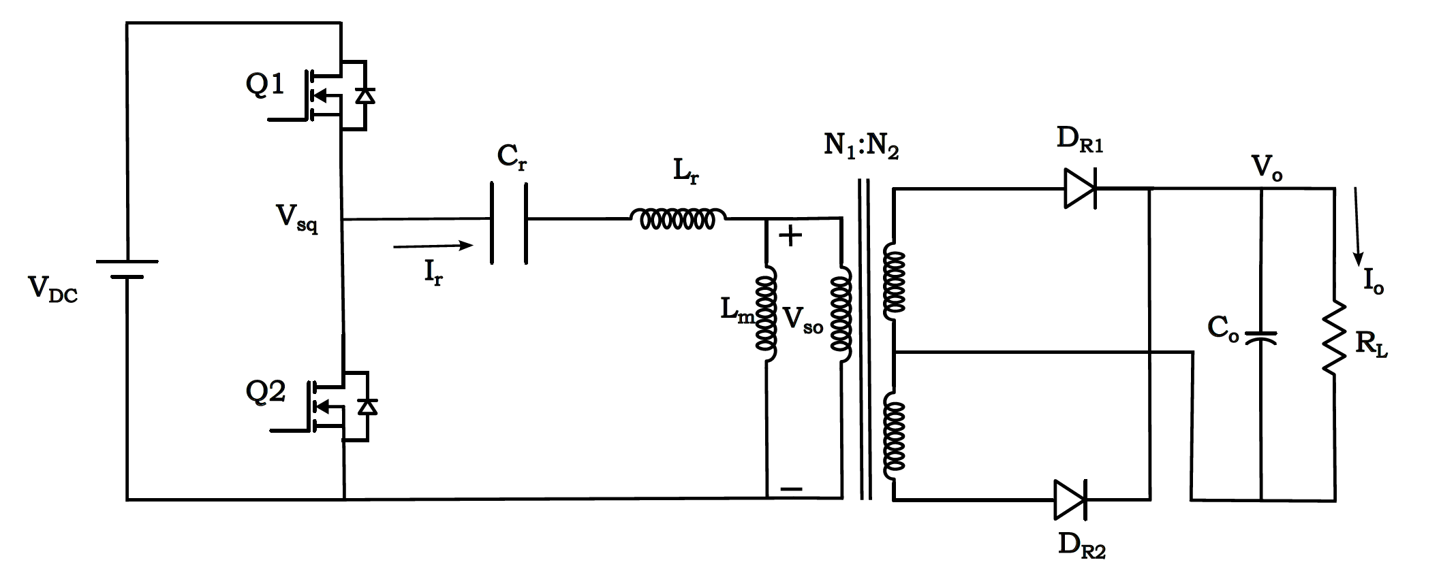
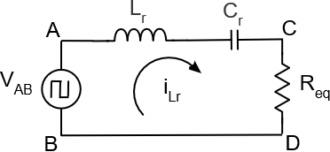
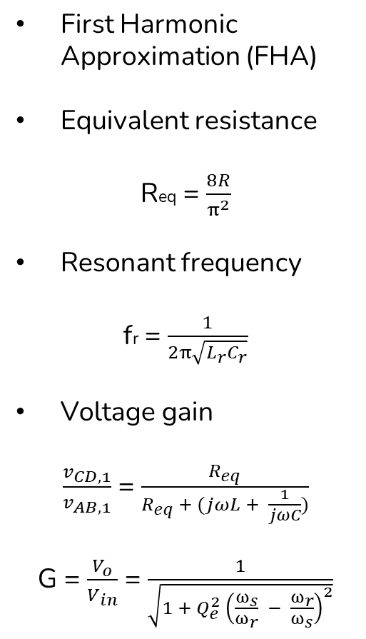
DC-DC Series Resonant Converter
First Harmonic Approximation (FHA)
Equivalent resistance
Req = $\frac{8R}{π^{2}}$
Resonant frequency
fr = $\frac{1}{2π\sqrt{L_{r}C_{r}}}$
Voltage gain
$\frac{v_{CD,1}}{v_{AB,1}}$ = $\frac{R_{eq}}{R_{eq} + (jωL + \frac{1}{jωC})}$
G = $\frac{V_{o}}{V_{in}}$ = $\frac{1}{\sqrt{1 + Q_{e}^{2}{ \left(\frac{ω_{s}}{ω_{r}} − \frac{ω_{r}}{ω_{s}}\right)}^{2}}}$
Equivalent circuit

Slide 4
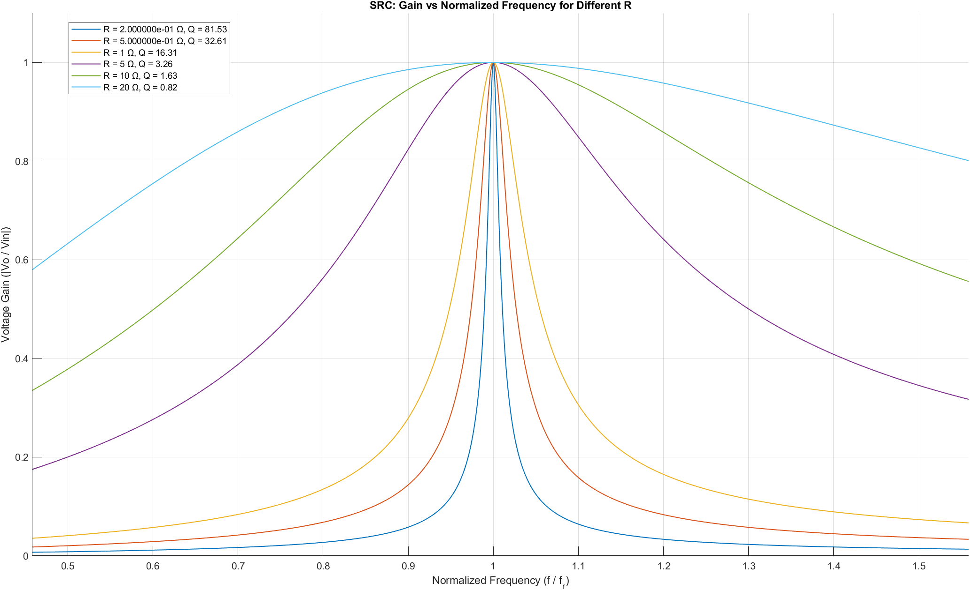
Gain vs. switching frequency curve
Light load
Heavy load

Slide 5
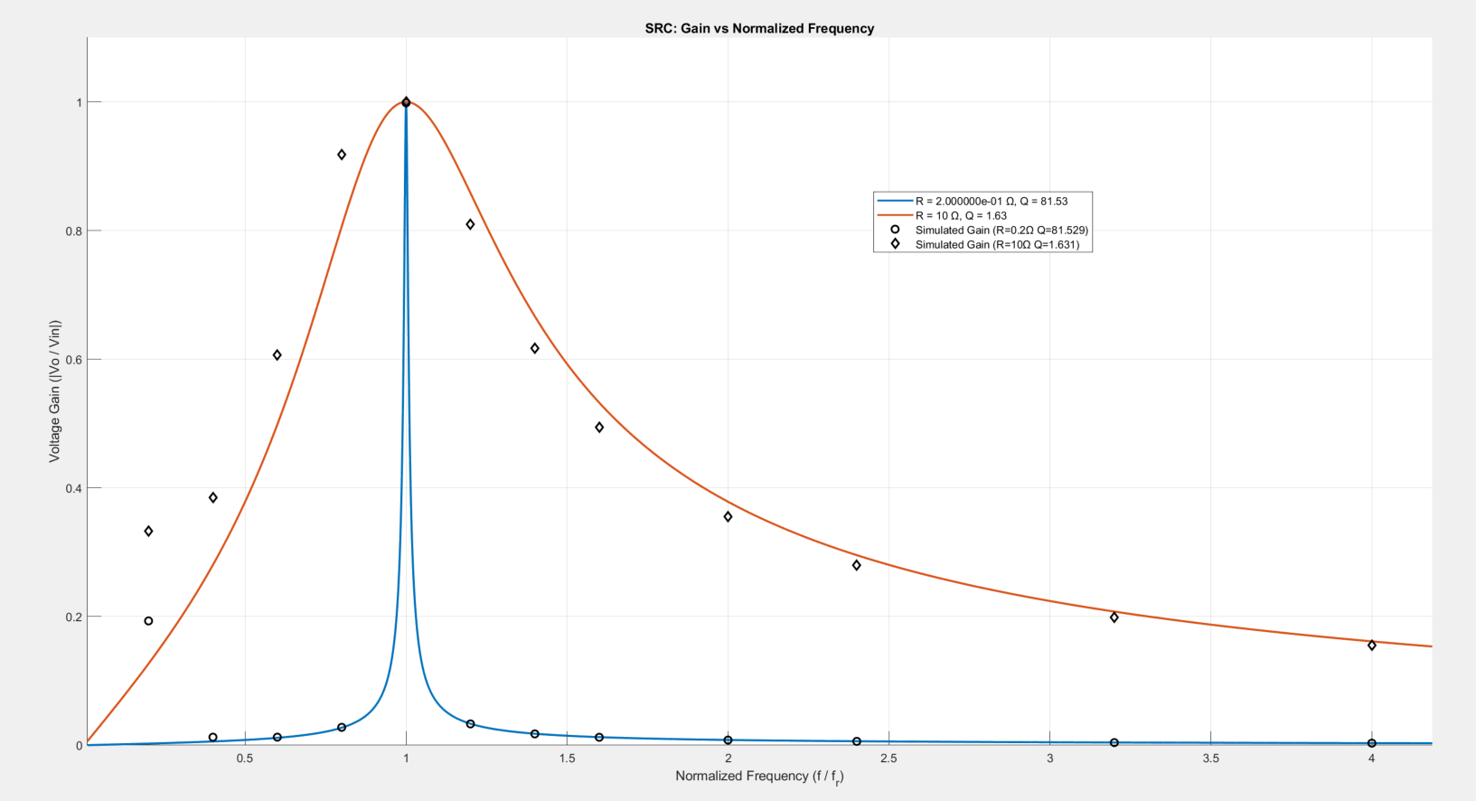
Analytical vs. Simulated Gain
Light load
Heavy load

Slide 6
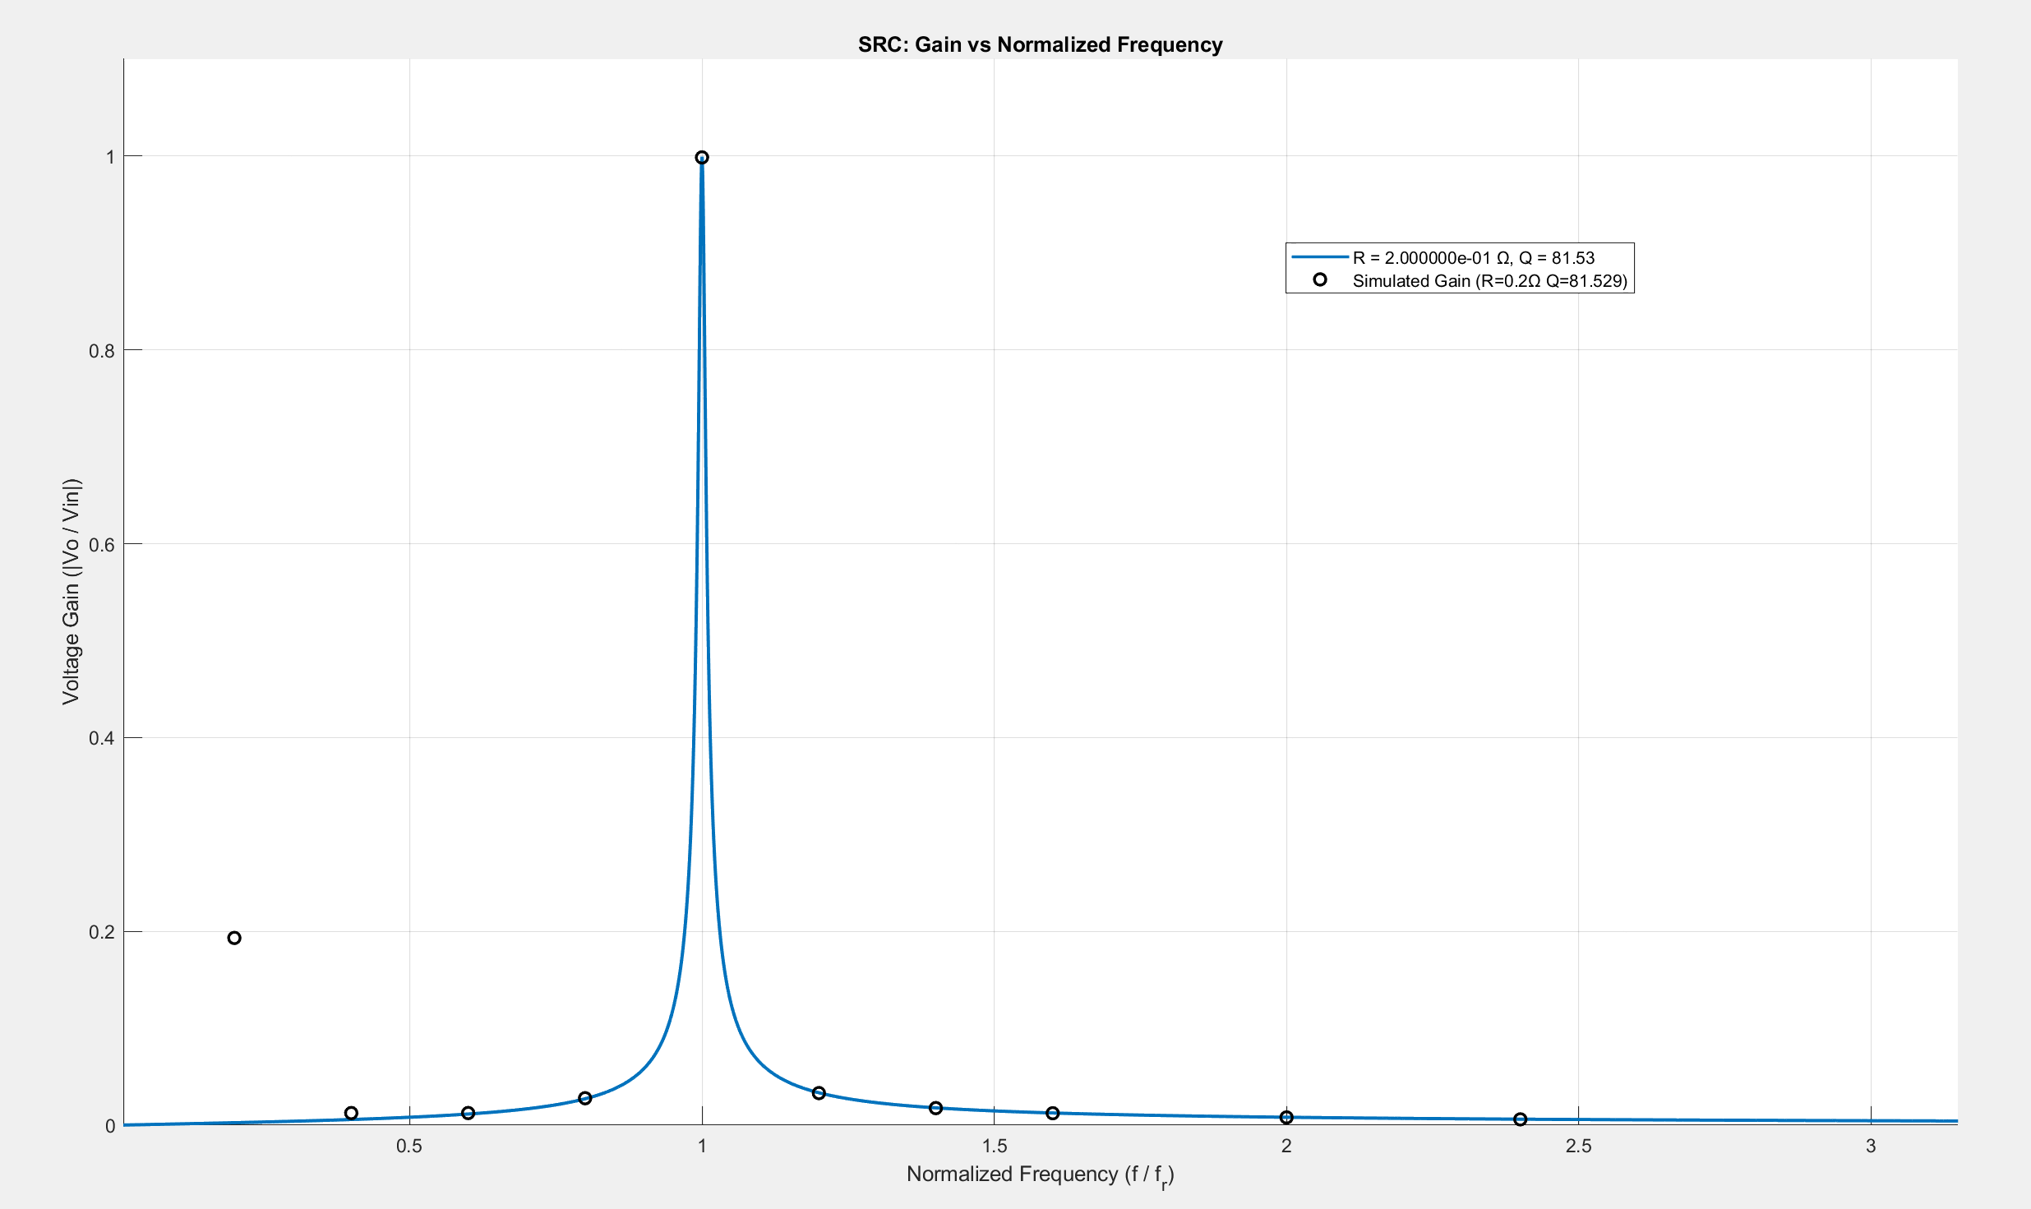
Analytical vs. Simulated Gain (R = 0.2 Ω)
 | Heavy Load
Analytical vs. Simulated (R = 0.2 ohm Q = 81.529)
fs (kHz) | Gain (calc) | Gain (simu) | Error %
5 | 0.0026 | 0.1932 | 98.6774
10 | 0.0058 | 0.0125 | 53.2748
15 | 0.0115 | 0.0125 | 8.0143
20 | 0.0272 | 0.0278 | 1.9903
25 | 1.0000 | 0.9986 | 0.1402
30 | 0.0334 | 0.0331 | 1.0056
35 | 0.0179 | 0.0176 | 1.6160
40 | 0.0126 | 0.0123 | 2.2689
50 | 0.0082 | 0.008 | 2.2096
60 | 0.0062 | 0.006 | 3.0700
80 | 0.0042 | 0.0041 | 3.6043
100 | 0.0033 | 0.0032 | 2.2125
120 | 0.0027 | 0.0026 | 2.7406
140 | 0.0023 | 0.0022 | 2.8371
160 | 0.0020 | 0.0019 | 3.3922
180 | 0.0017 | 0.0017 | 2.1798
200 | 0.0016 | 0.0015 | 3.8353
220 | 0.0014 | 0.0014 | 0.8605
240 | 0.0013 | 0.0013 | 0.6402
260 | 0.0012 | 0.0012 | 0.8012
280 | 0.0011 | 0.0011 | 0.3581
300 | 0.0010 | 0.001 | 2.9278

Slide 7
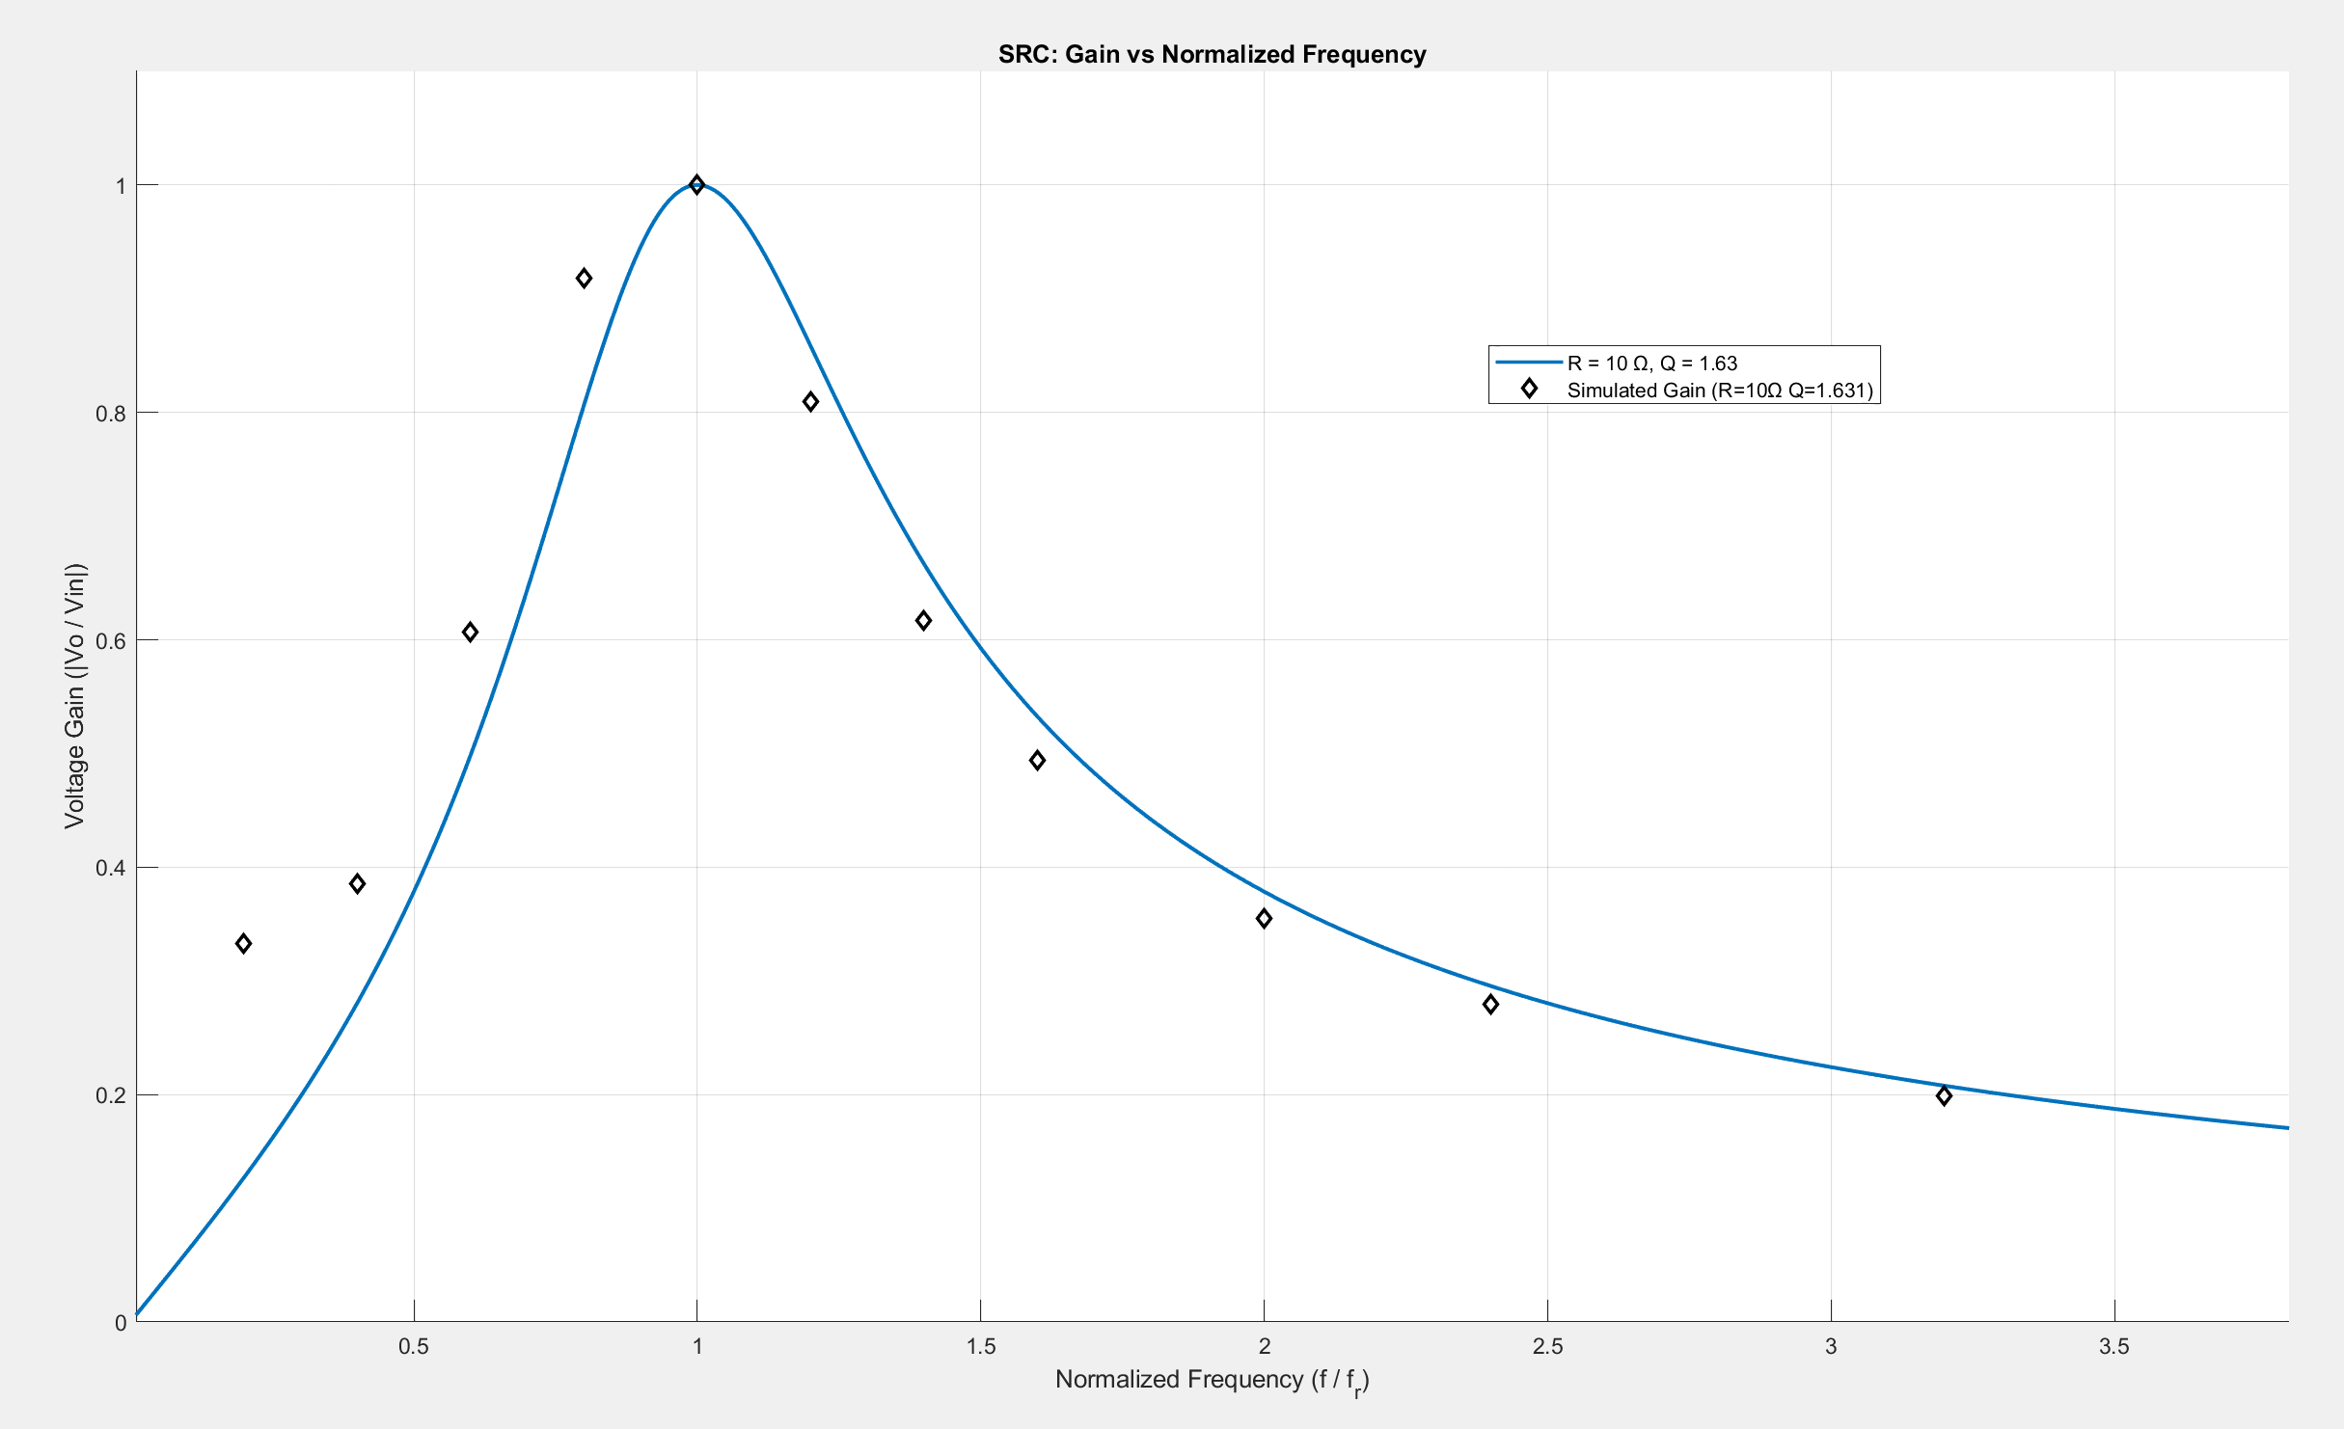
Analytical vs. Simulated Gain (R = 10 Ω)
 | Light Load
Analytical vs. Simulated (R = 10 ohm Q = 1.631)
fs (kHz) | Gain (calc) | Gain (simu) | Error %
5 | 0.1267 | 0.333 | 61.9411
10 | 0.2803 | 0.3854 | 27.2632
15 | 0.4984 | 0.6069 | 17.8716
20 | 0.8062 | 0.9182 | 12.1934
25 | 1.0000 | 1 | 0.0000
30 | 0.8583 | 0.8099 | 5.9754
35 | 0.6666 | 0.617 | 8.0455
40 | 0.5324 | 0.4939 | 7.8019
50 | 0.3784 | 0.3551 | 6.5738
60 | 0.2954 | 0.2797 | 5.6186
80 | 0.2078 | 0.1987 | 4.5579
100 | 0.1614 | 0.1551 | 4.0598
120 | 0.1324 | 0.1275 | 3.8335
140 | 0.1124 | 0.1084 | 3.6940
160 | 0.0978 | 0.0944 | 3.5512
180 | 0.0865 | 0.0836 | 3.5014
200 | 0.0776 | 0.0751 | 3.3842
220 | 0.0704 | 0.0681 | 3.4172
240 | 0.0644 | 0.0624 | 3.2847
260 | 0.0594 | 0.0575 | 3.3290
280 | 0.0551 | 0.0533 | 3.4017
300 | 0.0514 | 0.0498 | 3.2046

Slide 8
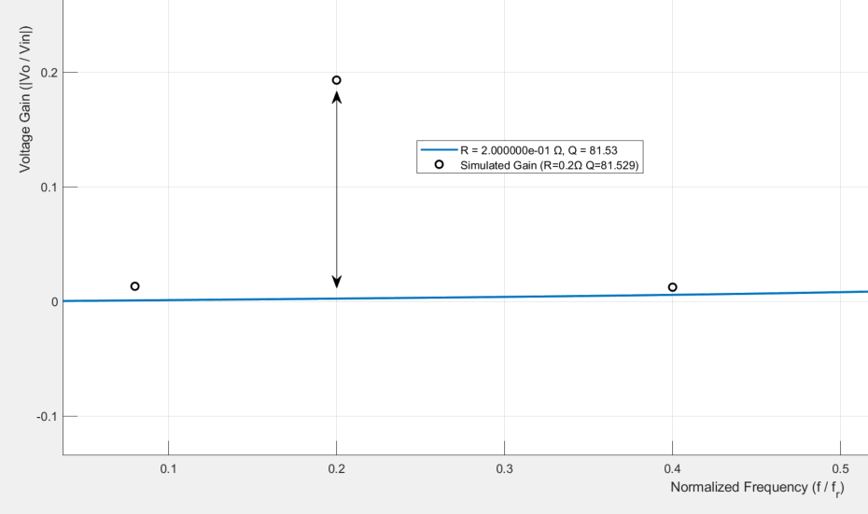
Irregularities (SRC)
Let’s change the loading conditions at 5 kHz
At R = 0.2 Ω
0.1932
0.0026
R | Gain (calc) | Gain (sim) | Error %
0.1 | 0.0013 | 0.1818 | 99.28
1 | 0.0128 | 0.1997 | 93.59
5 | 0.0638 | 0.2 | 68.1
10 | 0.1267 | 0.333 | 61.95
Error = 98.68 %

Slide 9
Key Observations and Inferences
For fs = fr
Gain = 1 (Maximum)
            For fs ≠ fr
            Gain < 1
For R = 0.2 Ω, Q = 81.529
For fs << fr : Simulated gain > Analytical gain
For fs = fr : Simulated gain = Analytical gain
For fs > fr : Simulated gain = Analytical gain
For R = 10 Ω, Q = 1.631
For fs < fr : Simulated gain > Analytical gain
For fs = fr : Simulated gain = Analytical gain
For fs > fr : Simulated gain < Analytical gain
Acts as Buck converter
Loading independent operation at fr
Peak occurs at fr
At no load, output voltage can not be regulated
Voltage regulation requires large fs variation
Some abnormalities are observed

Slide 10
Inductor Design (Ap method)

Slide 11
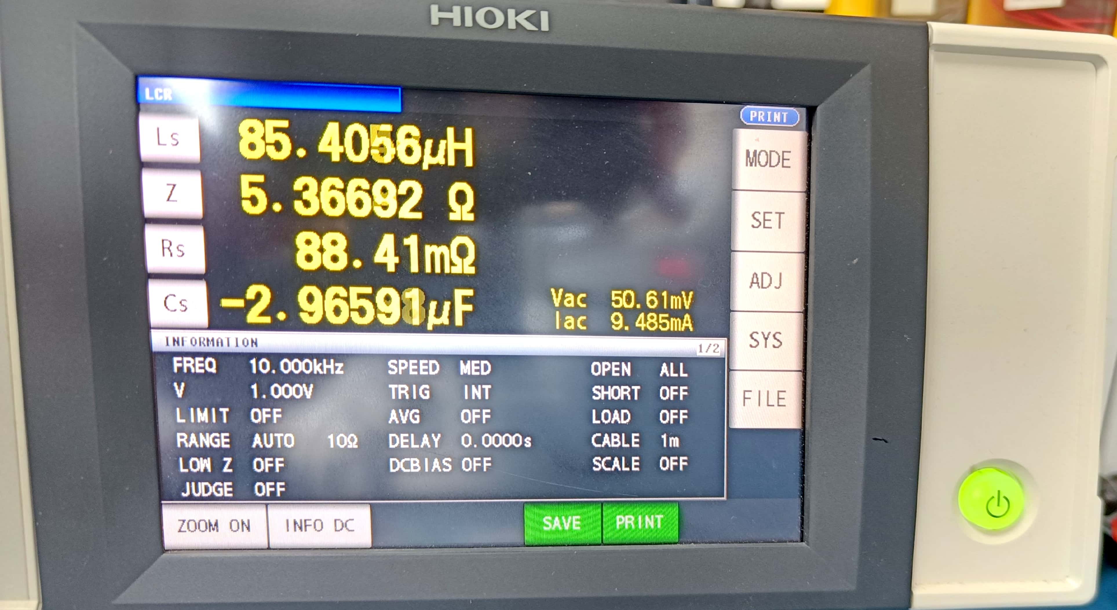
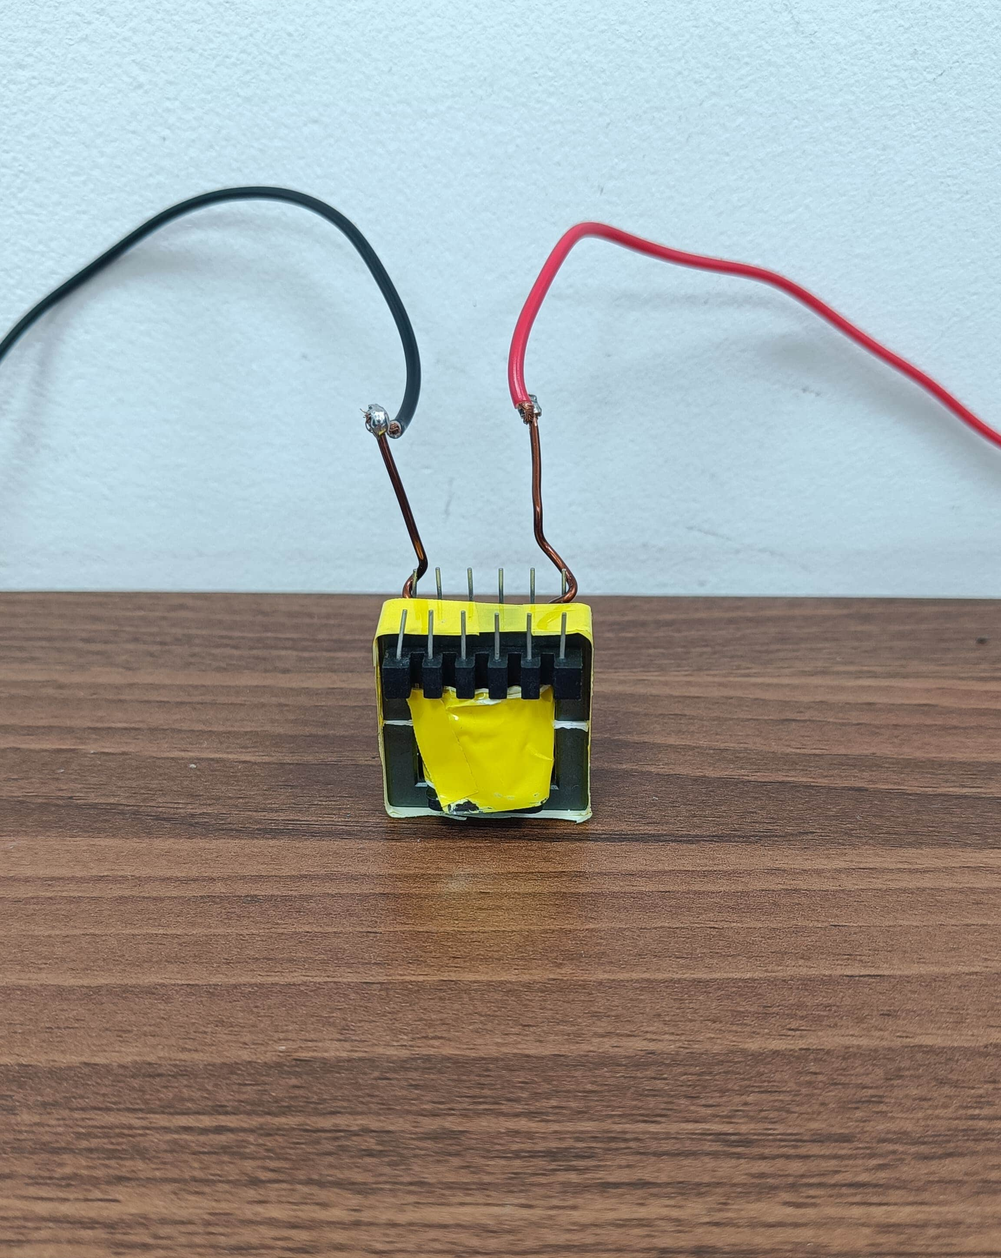
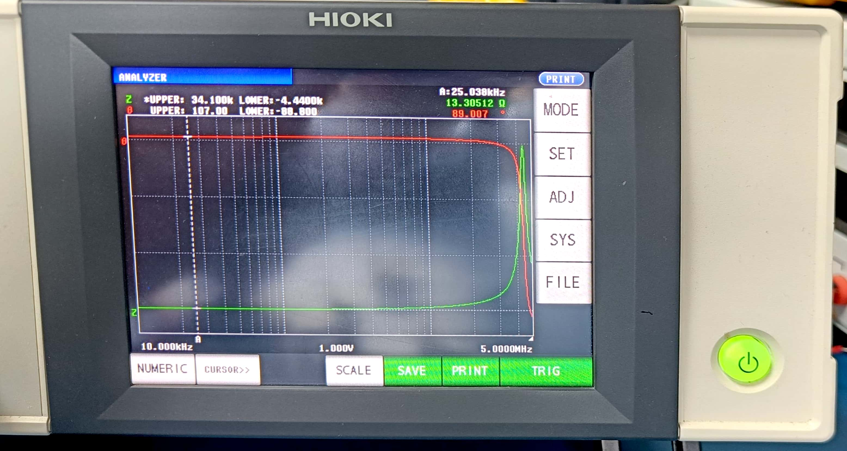
Inductor Design (cont.)
Impedance analyser display in LCR mode
Bode Plot of Inductor Impedance from Analyzer Mode

Slide 12
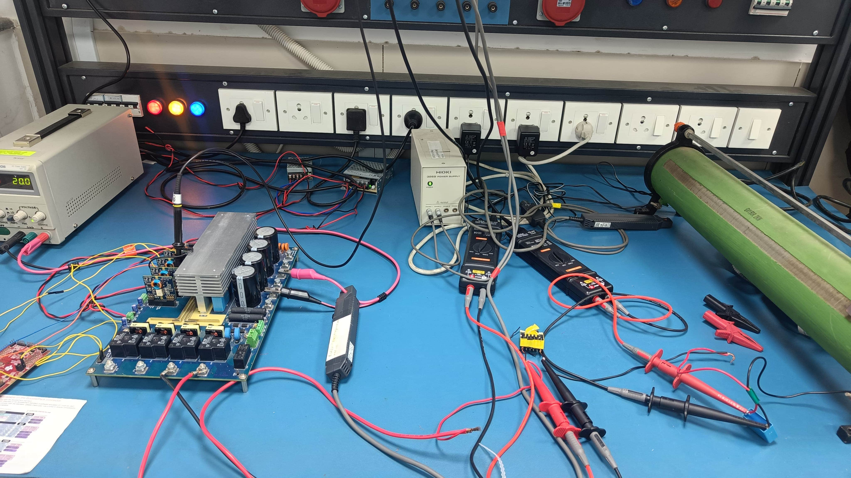
Experimental Setup
Specifications
Nova board – used as inverter
IGBTs - IKW25N120H3
Inductor – 84.142 µH, 5A (designed)
Capacitor – 481.67 nF, Bipolar
Load - 10Ω
Microcontroller – TMS320F28379D

Slide 13
Experimental Setup
Specifications
Nova board – used as inverter
IGBTs - IKW25N120H3
Inductor – 84.142 µH, 5A (designed)
Capacitor – 481.67 nF, 1 kV, Bipolar
Load - 10Ω
Microcontroller – TMS320F28379D

Slide 14
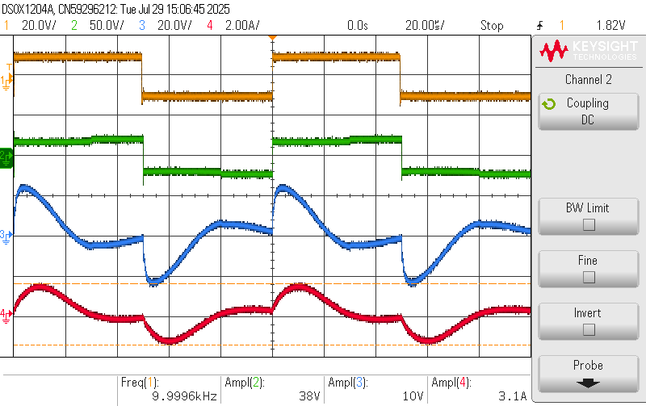
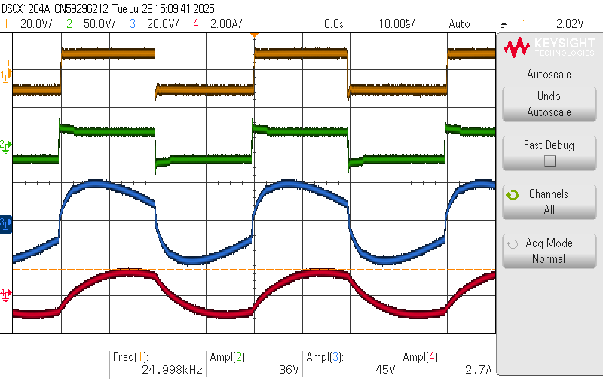
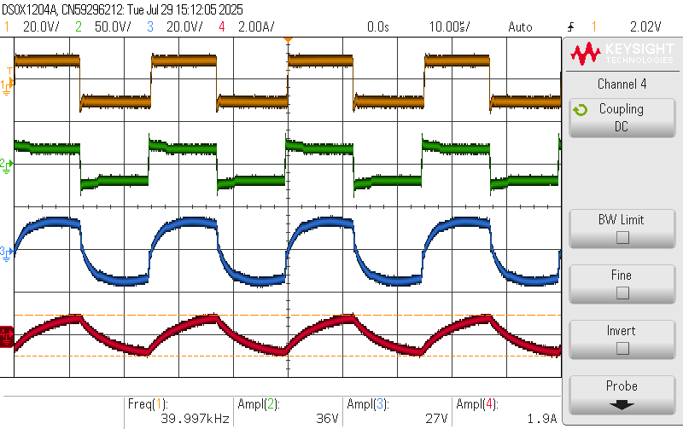
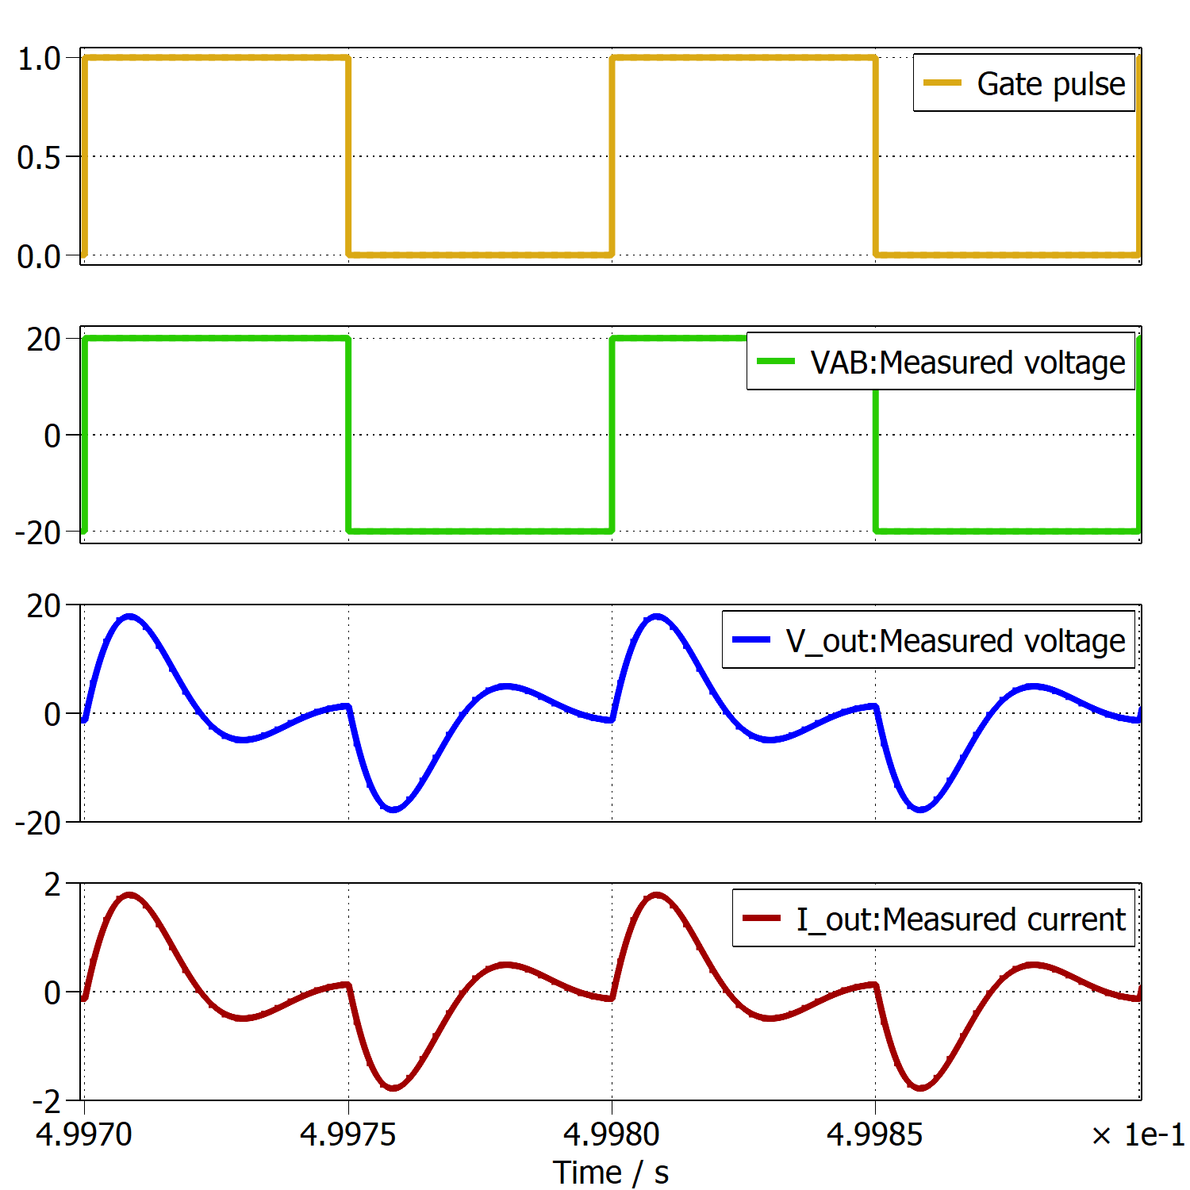
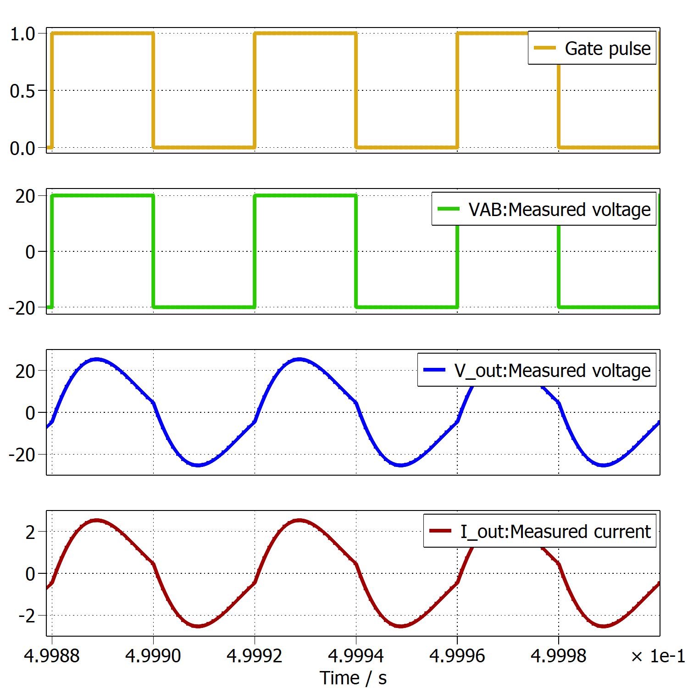
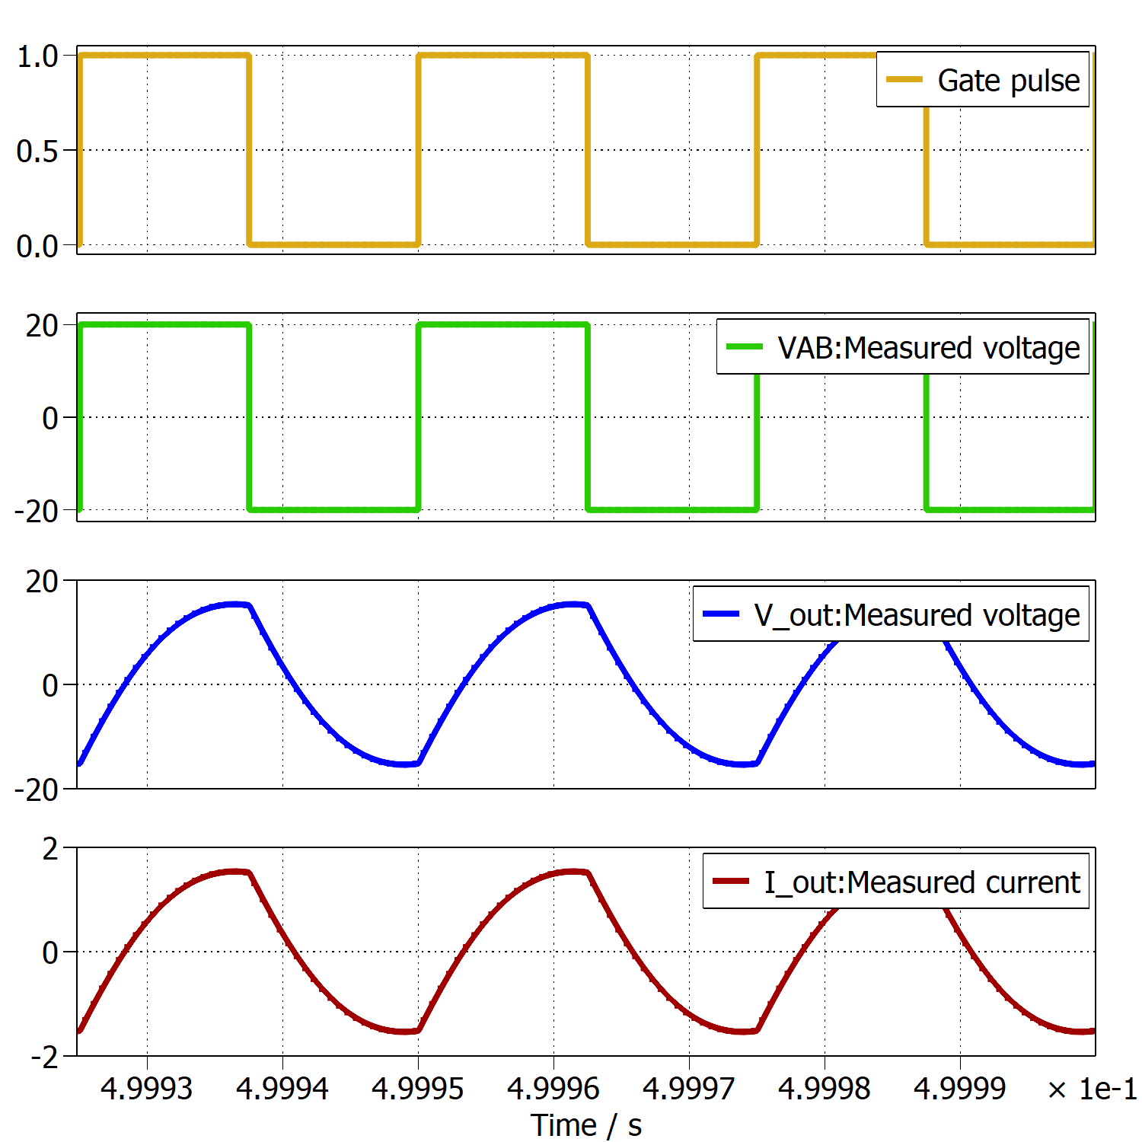
Series Resonant Inverter (SRI)
Gate, VAB, Vo, Io
Inferences
Simulation and experimental results are closely matching
10 kHz – Discontinuous conduction mode
Highest output voltage occurs at fr
Smooth waveforms at resonant frequency and above
Irregularity – Spikes appear in inductor voltage even at high frequencies in hardware experiment
fsw = 10 kHz
fsw = 25 kHz
fsw = 40 kHz

Slide 15
Series Resonant Inverter (SRI)
Gate, VAB, Vo, Io
Inferences
Simulation and experimental results are closely matching
10 kHz – Discontinuous conduction mode
Highest output voltage occurs at fr
Smooth waveforms at resonant frequency and above
Irregularity – Spikes appear in inductor voltage even at high frequencies in hardware experiment
fsw = 10 kHz
fsw = 25 kHz
fsw = 40 kHz

Slide 16
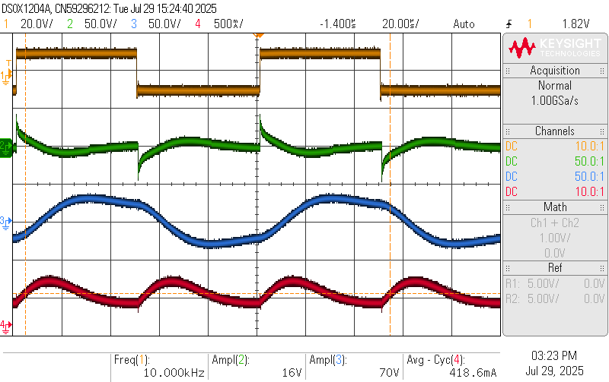
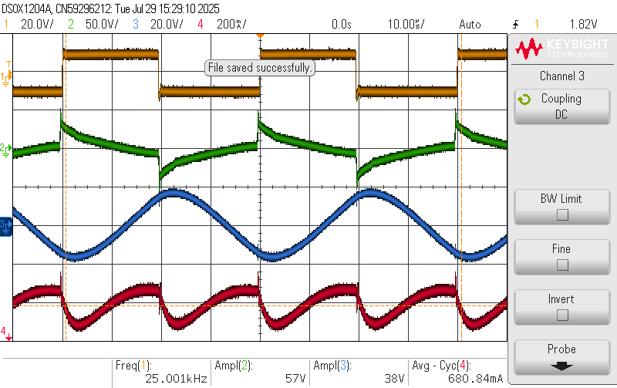
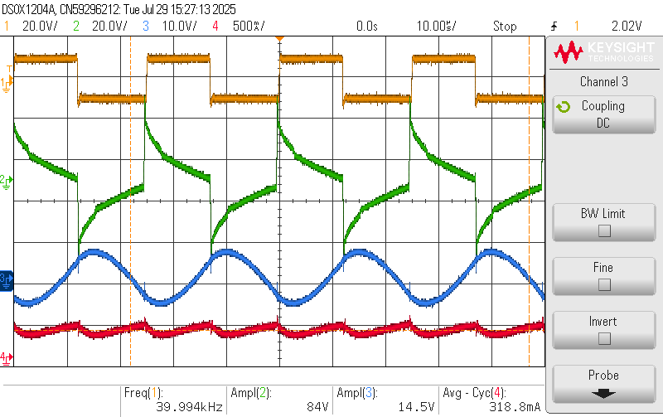
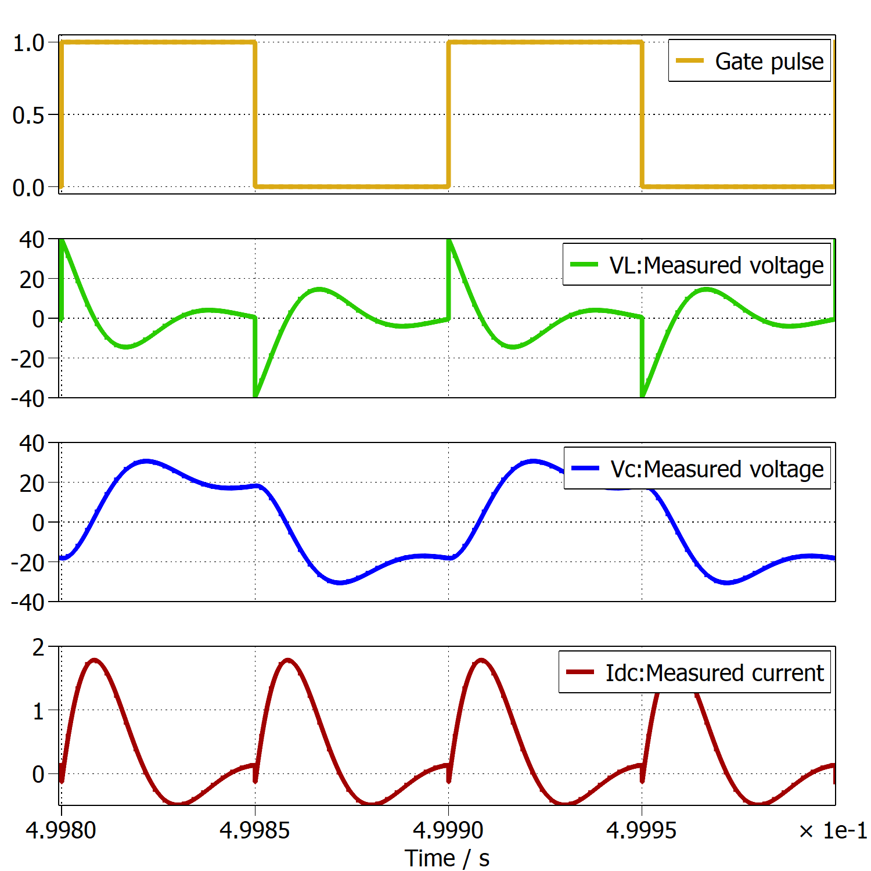
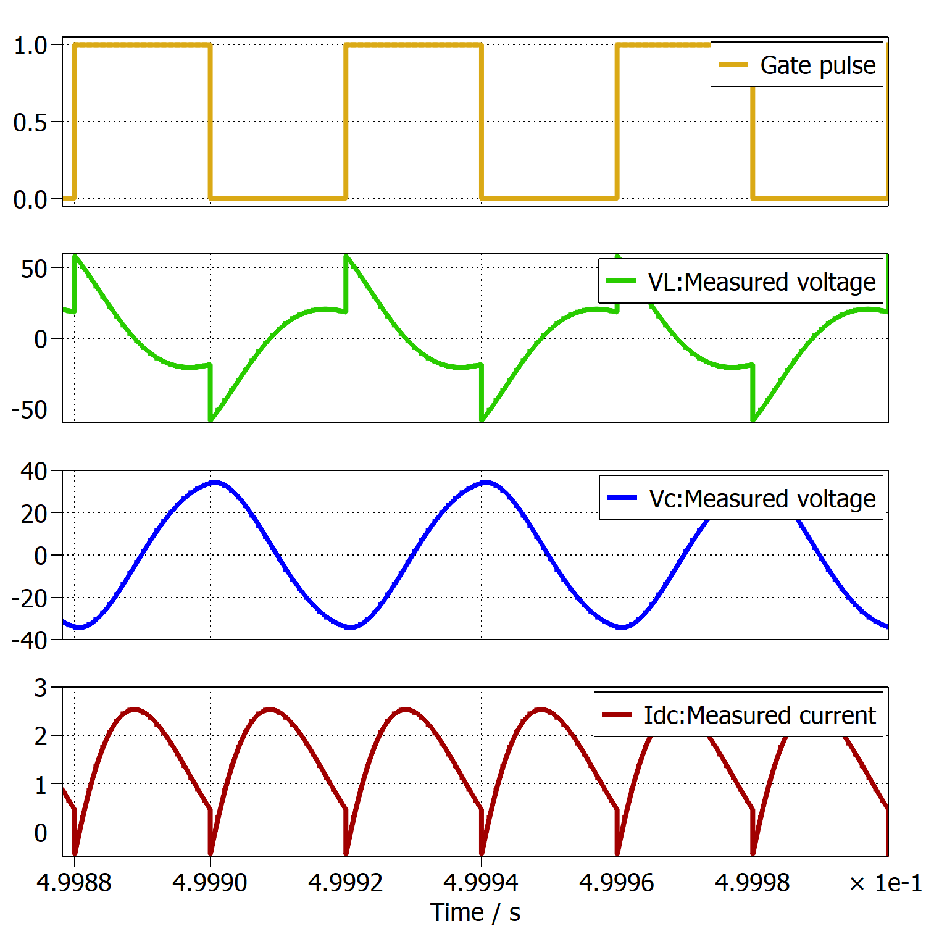
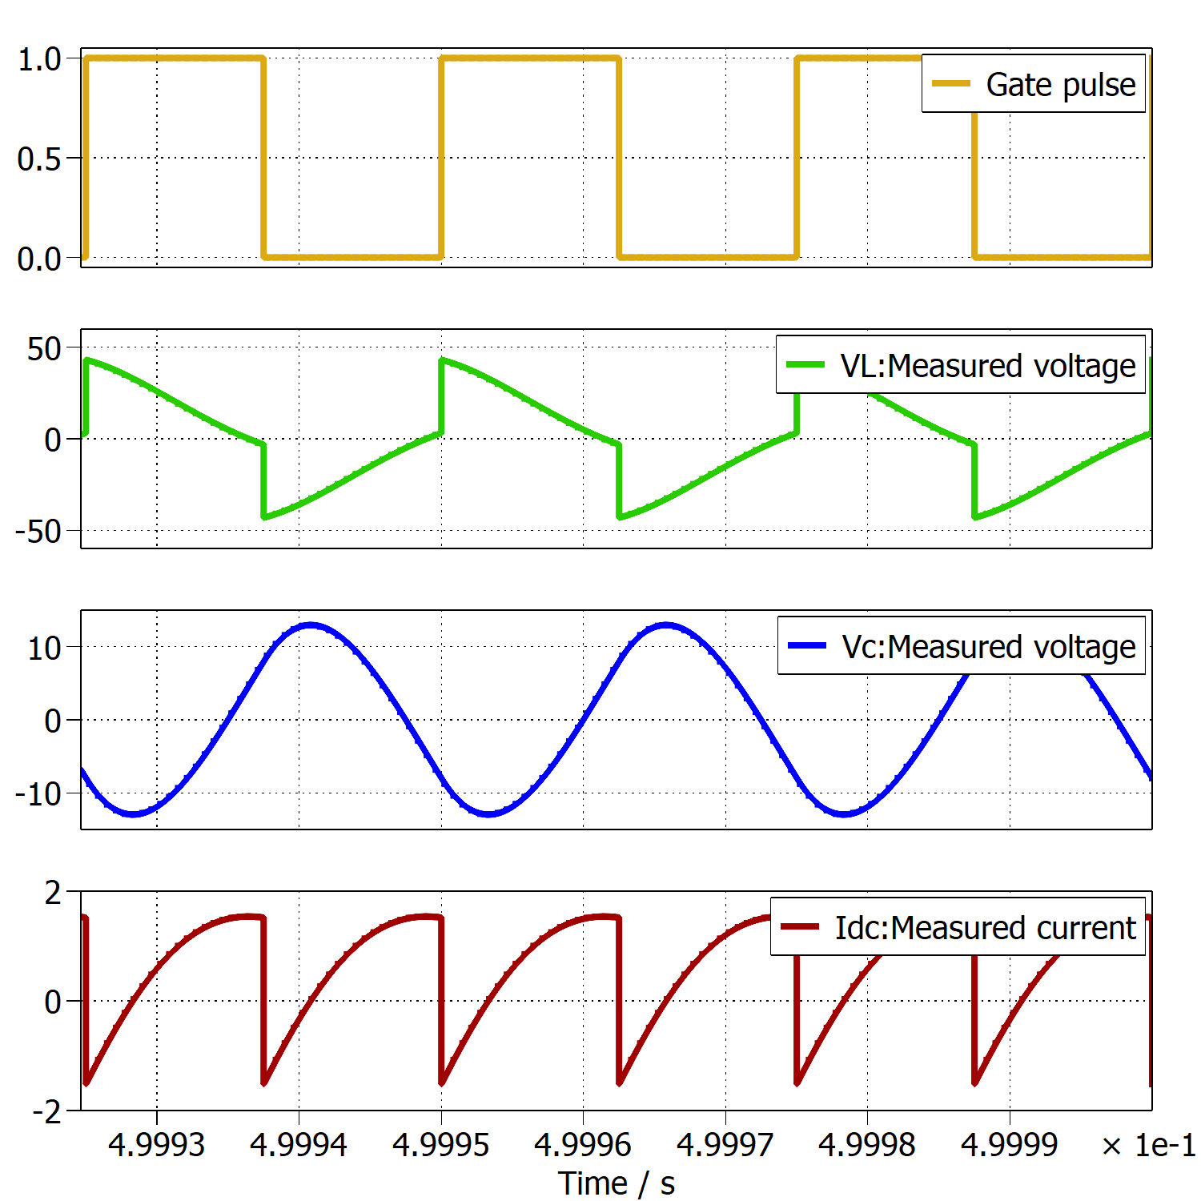
Series Resonant Inverter (cont.)
Gate, VL, VC, Idc
fsw = 10 kHz
fsw = 25 kHz
fsw = 40 kHz

Slide 17
Parameter values

Slide 18
Key Takeaways and Conclusion
Drawback with SRC – Switching frequency variations are large even for slight change in output voltage
Future Work
Moving to PRC resonant converter in next stage
PRC – Design and Control

Slide 19
Thank You

